Slide 1
Energy Efficiency Challenges and Opportunities
Barış Sanlı

Slide 2
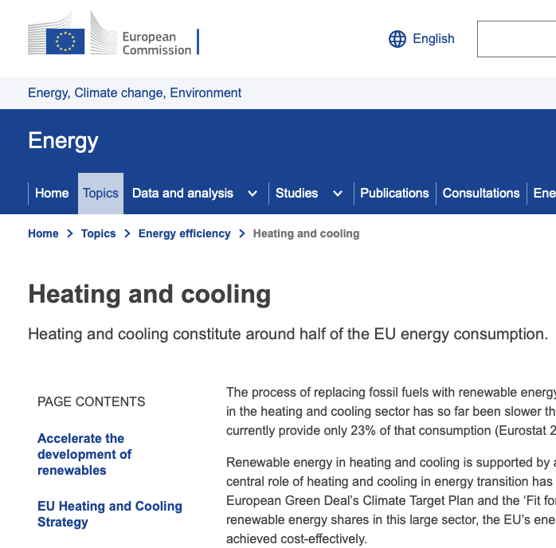

Slide 3
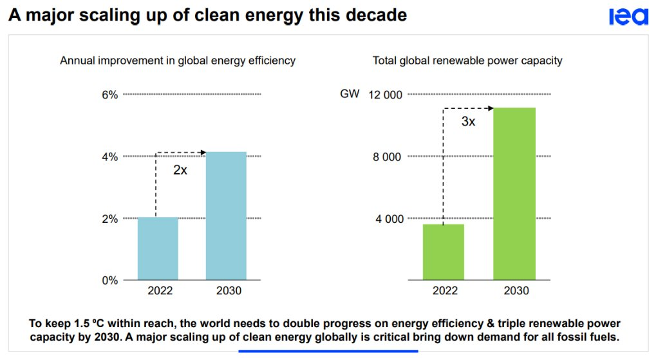
For climate targets

Slide 4
Summary
Main Points
Nuts & Bolts of Energy Demand (Weather & Temperature example)
Main questions
Data
Heating dynamics
Cooling dynamics
And how solar generation interacts with these
Consumer
Knowledge-Action Gap
Policy design with behavioral tools

Slide 5
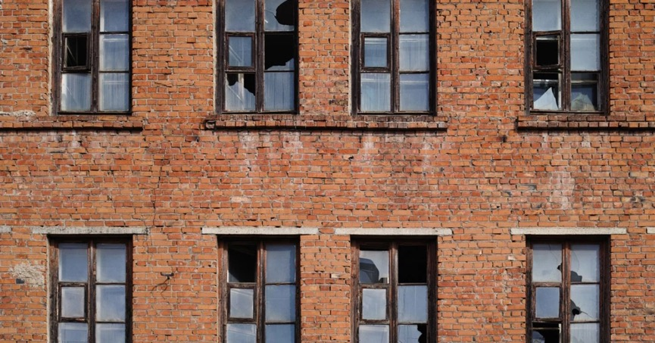
Broken Windows Theory and Energy Efficiency
“One unrepaired broken window is a signal that no one cares, and so breaking more windows costs nothing.”
https://www.psychologytoday.com/ie/basics/broken-windows-theory

Slide 6
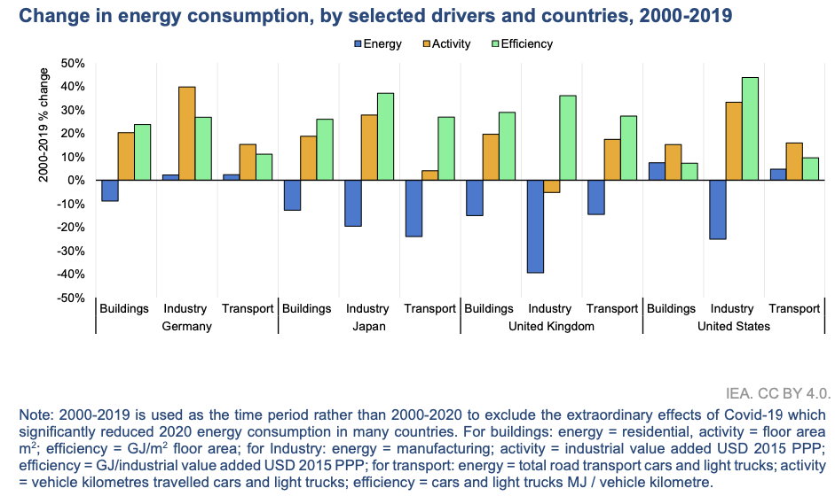
How IEA sees it?
https://www.iea.org/reports/energy-efficiency-2022

Slide 7
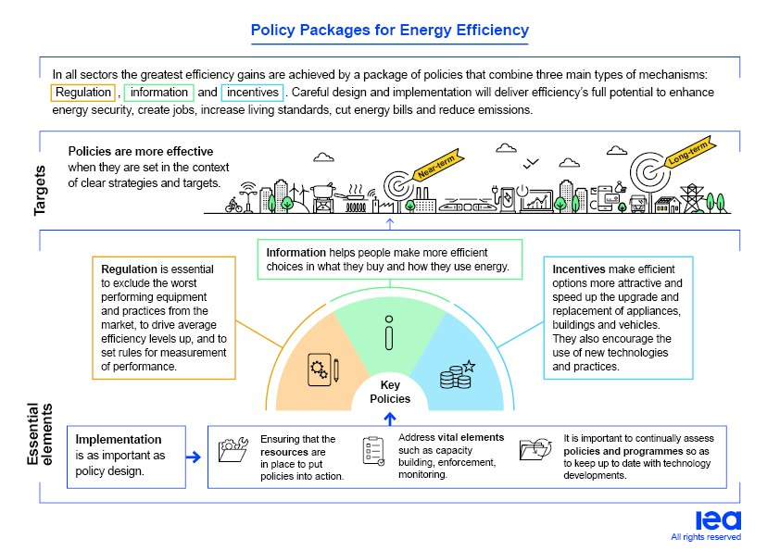
https://www.iea.org/reports/energy-efficiency-the-decade-for-action/energy-efficiency-policy-toolkit-2023-from-sonderborg-to-versailles#abstract

Slide 8
Global Primary Energy Intensity
https://www.iea.org/reports/energy-efficiency-2022

Slide 9
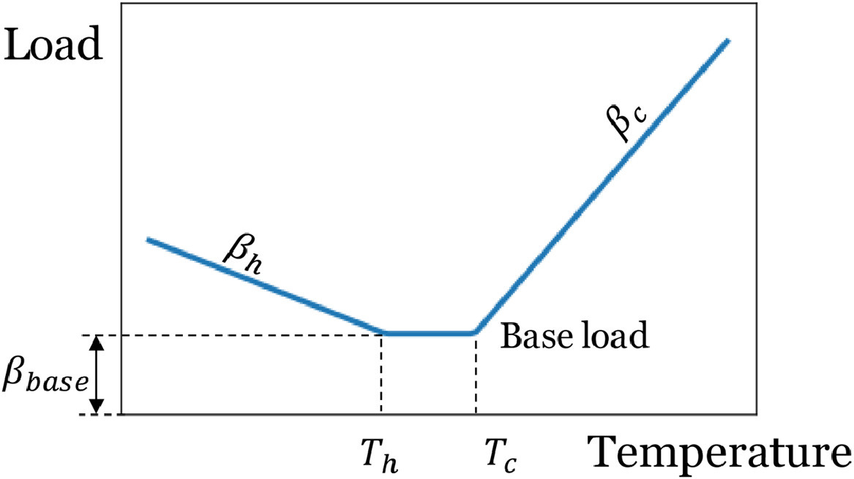
Theory
Demand = f(human activity, temperature, economic activity)

Slide 10
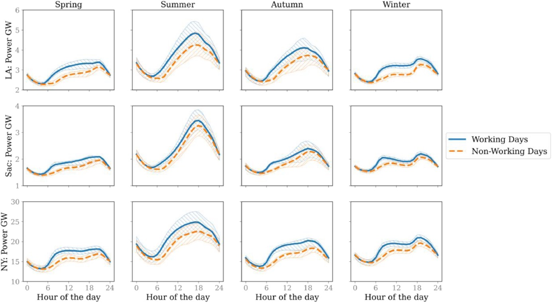
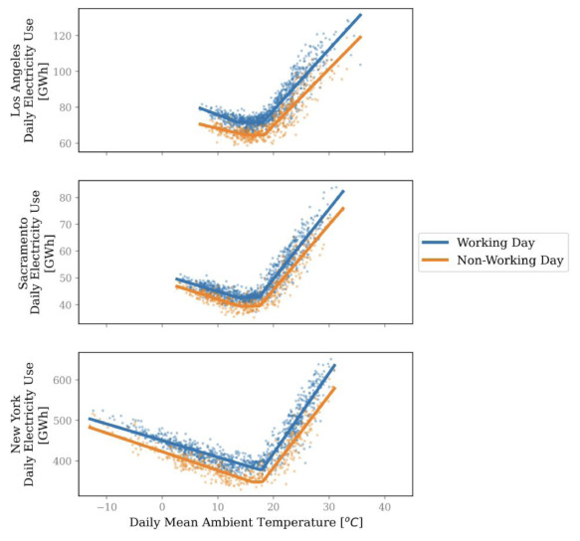
Hourly demnad
https://www.sciencedirect.com/science/article/pii/S2666792421000184

Slide 11
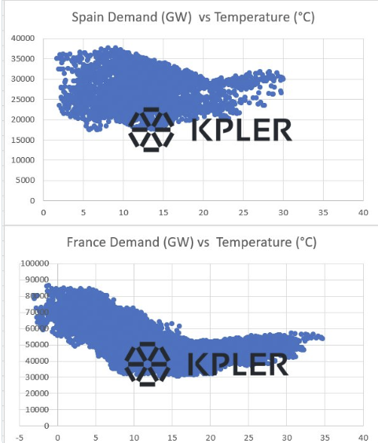
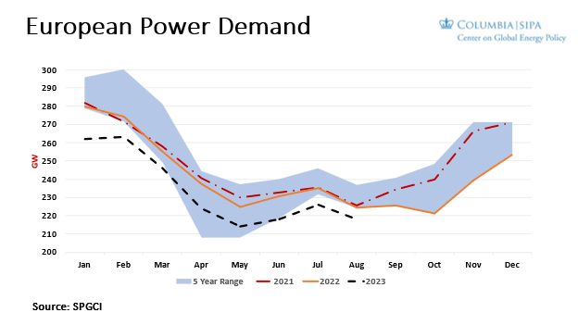
Weather Effect

Slide 12
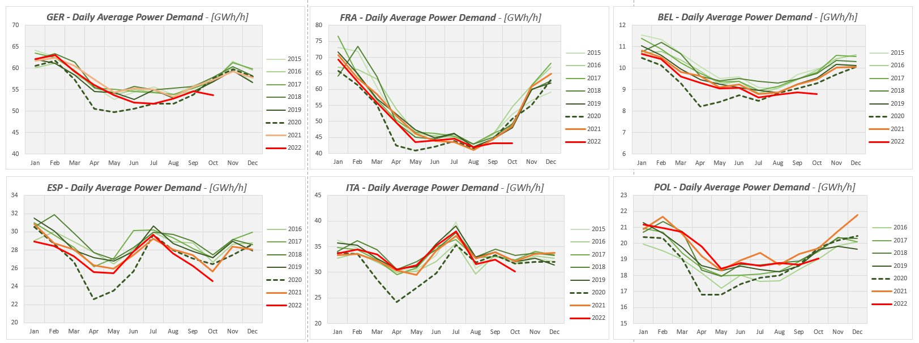
Power Demand

Slide 13
Cooling and electricity demand
“In Texas, for example, every 1°C increase in the average daily temperature above 24°C drives a rise of about 4% in electricity demand. In India, where air conditioner ownership is lower, the same temperature increase drives a 2% rise. ”
https://www.iea.org/commentaries/keeping-cool-in-a-hotter-world-is-using-more-energy-making-efficiency-more-important-than-ever

Slide 14
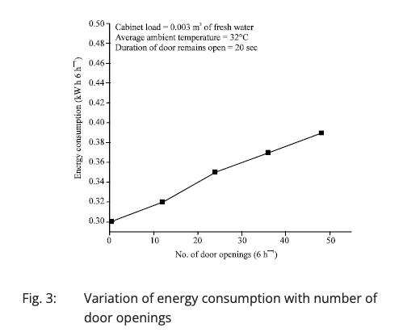
How usage impacts demand?
https://scialert.net/fulltext/?doi=ajaps.2014.79.87

Slide 15
But people are not buying?
https://www.iea.org/commentaries/keeping-cool-in-a-hotter-world-is-using-more-energy-making-efficiency-more-important-than-ever

Slide 16
Impact of social events
National Grid ESO

Slide 17
Weather Impact
https://www.iea.org/commentaries/europe-s-energy-crisis-understanding-the-drivers-of-the-fall-in-electricity-demand

Slide 18
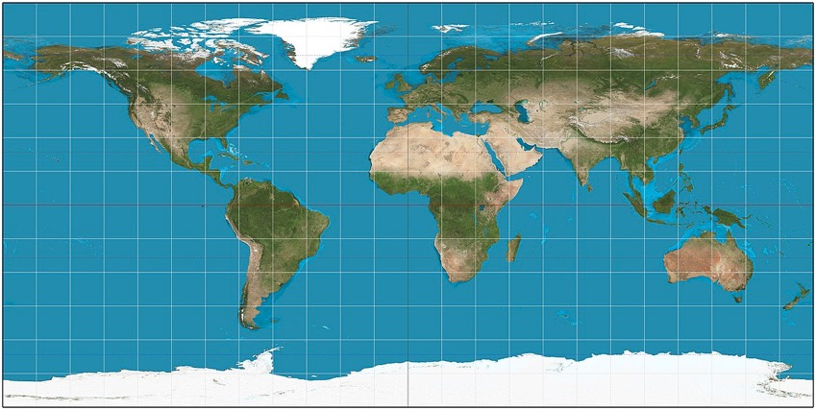
Here comes the sun
Summer Generation
Winter Generation

Slide 19
More Electric? Demand and Infrastructure
https://thundersaidenergy.com/downloads/power-grids-transmission-and-distribution-kilometers-by-country/

Slide 20
A fundamental assumption of energy consumer
Is energy consumer rational?
Knowledge action gap in Türkiye
Green nudging the energy crisis, Barış Sanlı, Network Industries Quarterly, Vol. 24, issue 2, 2022 (July)

Slide 21
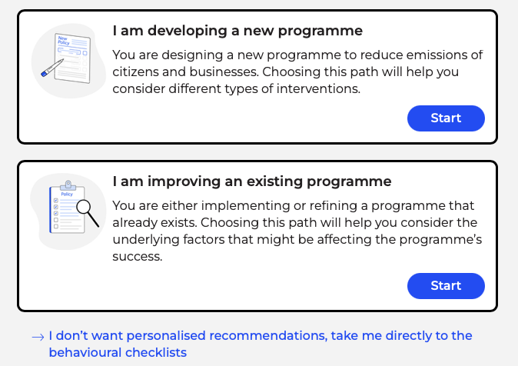
Behavioural Insights - BIToolkit
https://www.bitoolkit.userstcp.org

Slide 22
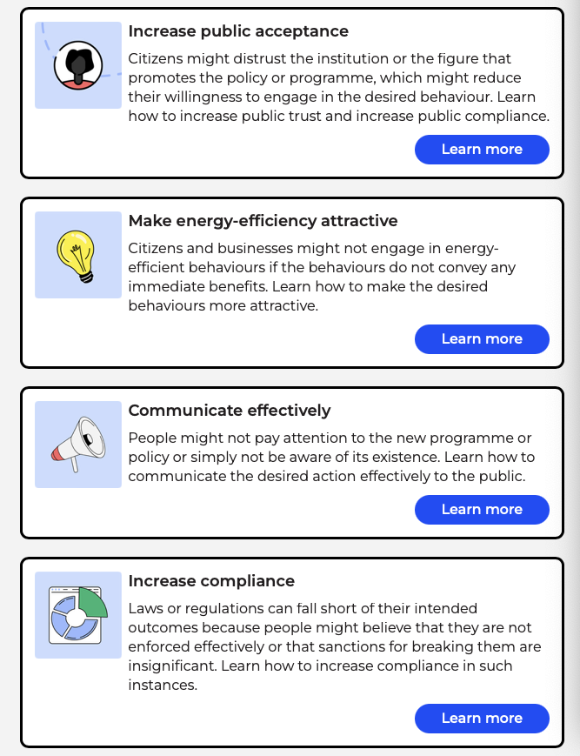
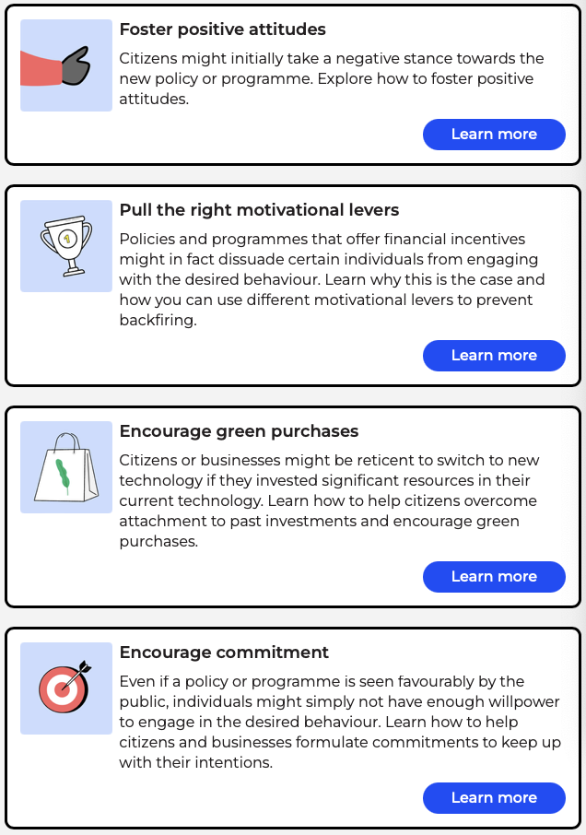
BI - Checklist

Slide 23
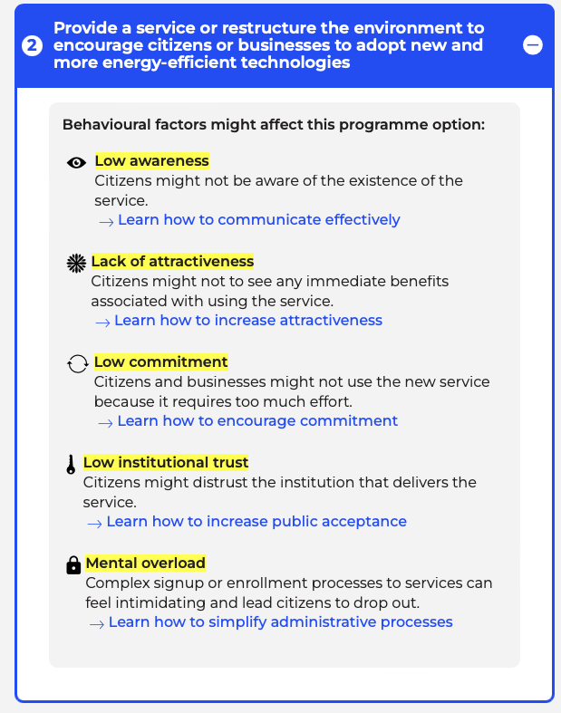
A more nuanced policy design

Slide 24
Before closing
Question:
Find a government energy efficiency program
Use BIToolkit to recreate such a policy
Check scholar.google.com for such programs & results
Offer “tweaks” for such programs

Slide 25
Future of Energy Markets
More insight about consumer
Still heating & cooling demands will be important
Energy efficiency is the first tool
Electricity markets have 3 major problems
Time shifting (storage) (In oil we have 90 days of storage, can it avoid crisis?)
Competition of Zero Marginal Cost Resources
How to compete among three similar solar panels (in fossil fuels, efficiency)
The new understanding of consumer
Classic consumer + Behavioral Insights

Slide 26
Thank you Questions?

